Slide 1


Lecture 2 PT5053
Quantitative Research Designs in Healthcare
Lucy Metcalfe
Senior Physiotherapy Lecturer
lmetcalfe1@londonmet.ac.uk

Slide 2
Purpose of Quantitative Research
Quantitative research is about measuring, counting and testing relationships using numerical data.
Its purpose includes:
Describing phenomena numerically (e.g. prevalence of LBP)
Testing hypotheses and identifying cause-effect relationships
Measuring change over time
Predicting outcomes
Generalising findings to wider populations

Slide 3

Quantitative research emphasises
Objectivity
Replicability
Use of statistics
Structured methods

Slide 4
Common Quantitative Study Designs
Quantitative designs fall into two broad categories
A) Experimental Designs
Research manipulate an intervention / exposure and control allocation
RCT – Randomised Controlled Trials
Evidence from RCTs is considered to be at the TOP of the evidence pyramid

Slide 5
Observational Designs
Research observes what happens naturally without manipulating the exposure.
Types of research:
Cohort Studies
Case control studies
Cross sectional studies

Slide 6

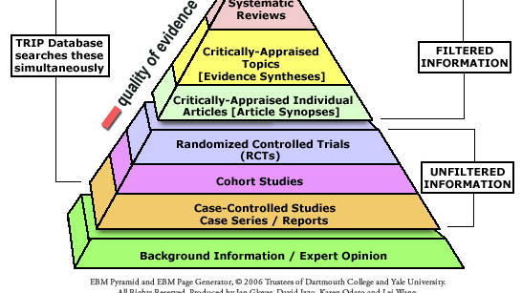

Slide 7
Randomised Controlled Trials RCTs
Definition: Are prospective studies that measure the effectiveness of a new treatment or intervention (Hariton and Locascio)
Key Features:
Randomisation – balances participants characteristics between groups
Control or comparison group
Prospective Design
Often blinded (single / double) = participants, clinicians, researchers
The RCT should have a very well defined, clear RCT protocol

Slide 8
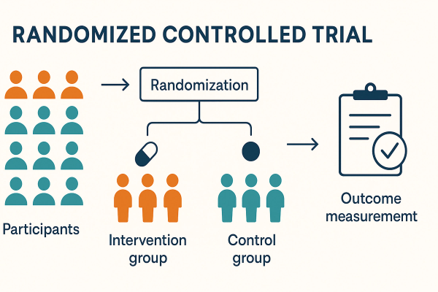
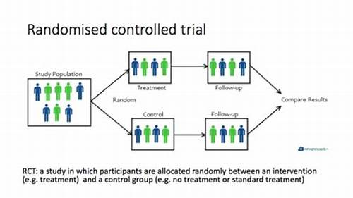

Slide 9
Randomised Control Trials RCTs
Researches must carefully define the:
Population
Inclusion and exclusion criteria
Process of randomisation
Allocation
Blinding of intervention
Treatment and control
Outcome of interest (outcome measures)
Sample size required using power calculation
(Hariton and Locascio; Bhide et al.)

Slide 10
RCT – Random Allocation
Each of the eligible participants should have an equal chance to be allocated the intervention or not.
Simplest way = parallel group design (intervention and control)
If a particular baseline characteristic is of importance as will have an outcome on the results; it can be considered at randomisation
Participants with or without baseline characteristics are randomly separated
(Hariton and Locascio; Bhide et al.)

Slide 11
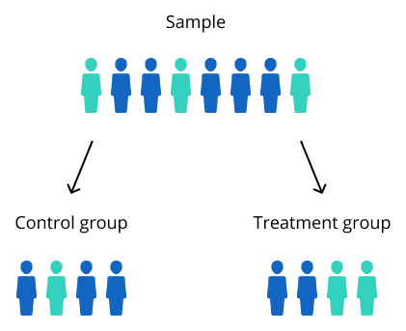
Types of Randomisation in RCT
1. Simple Randomisation: participants are assigned to treatment groups purely at random (random number generators). It can lead to imbalances in group sizes or characteristics – potentially affecting the validity of results.

Slide 12
Types of Randomisation in RCT
2. Stratified Randomisation: Accounts for specific variables such as age, gender, or baseline health conditions – that could influence treatment outcomes.
Participants are grouped into strata based on these variables and randomised.
This method reduces the risk of confounding and ensures a balance distribution of key characteristics across groups.

Slide 13
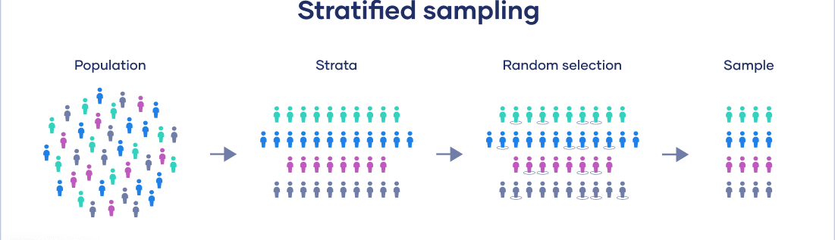
Stratified Sampling - Randomisation

Slide 14
Types of Randomisation in RCT
3. Blocked Randomisation: ensures equal number of patients in each study group

Slide 15
RCT - Blinding
To eliminate BIAS
Single blinded – participants blinded
Double blinded – participants AND investigators blinded
To eliminate unconscious information bias
It is not always possible to blind the participants or investigators due to the nature of the RCT
(Hariton and Locascio; Bhide et al.)

Slide 16
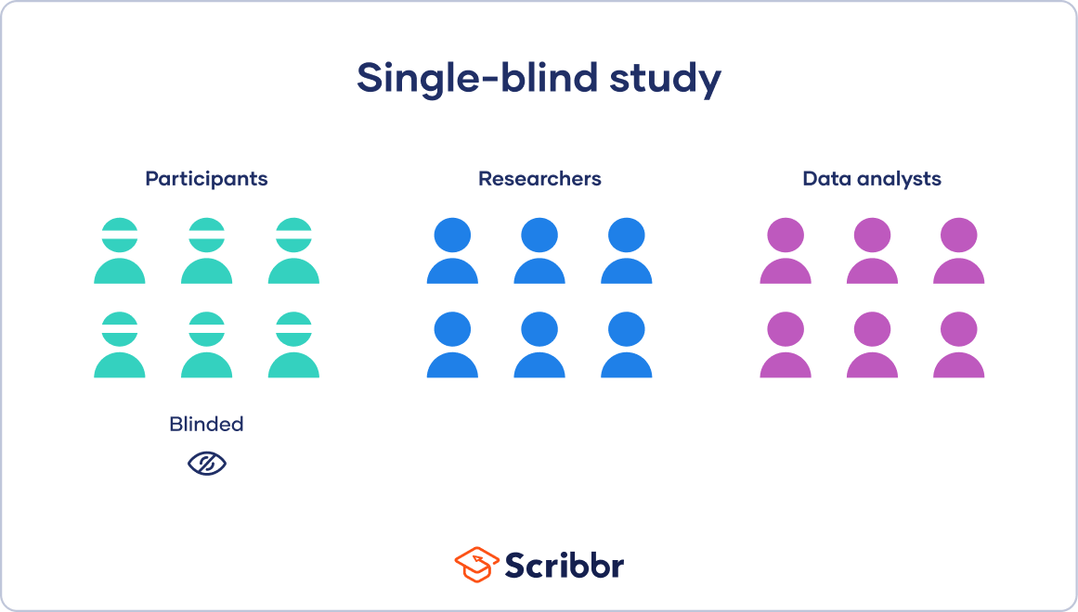
RCT Blinding
Single blinded: Participants do not know which group they have been placed in until the experience has finished
Very difficult in physiotherapy research
Most commonly used for medicine

Slide 17
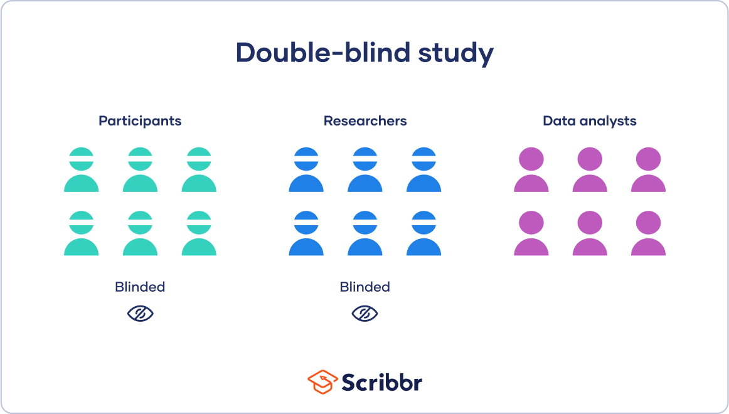
RCT Blinding
Double Blinding – the group assignment is hidden from both the participant and the researchers

Slide 18
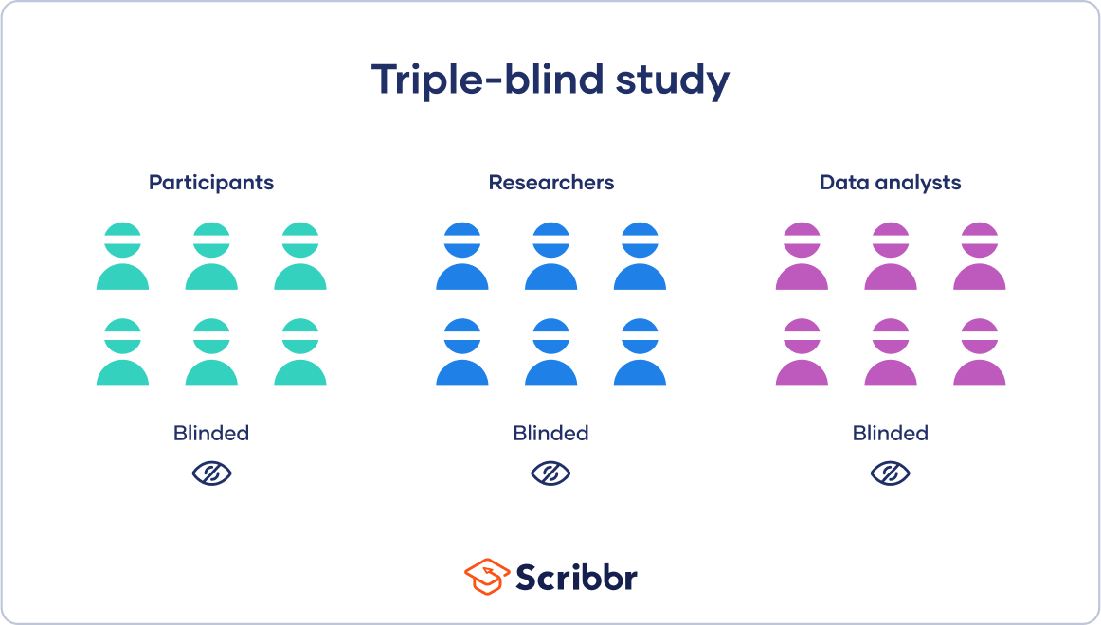
RCT Blinding
Triple Blind Studies: Occurs when group assignment is hidden from the participants, researchers and data analysts

Slide 19
RCT – Collection of Outcome Measures
Primary and secondary outcomes should be collected by independent observers who are unaware of the allocation and treatment arms of the participants.
Outcome measures taken at baseline, post intervention and follow up (long term if able)
(Hariton and Locascio; Bhide et al.)

Slide 20
RCT – Sample Size
Aim: conduct a study that has adequate sample size and power so that the conclusions generated from the experiment can be applied with confidence
The required sample size to test a hypothesis is governed by the effect size
(Hariton and Locascio; Bhide et al.)

Slide 21
RCT – Power of a study
If there are significant differences in the primary outcome between the two groups, one can conclude that the difference is likely to be due to the intervention
Significant = probability is <0.05 (p) value
(Hariton and Locascio; Bhide et al.)

Slide 22
Factors to consider
Bias: systematic tendency of any factors associated with the design, conduct, analysis, evaluation and interpretation of the results of a study to make the estimate of the effect of a treatment or intervention deviate from its true value.
In Physiotherapy:
Selection bias – non representative groups?
Information bias – inaccurate measurement?
Financial incentive?
Treatment bias?
Detection bias – lack of blinding?
(Hariton and Locascio; Bhide et al.)

Slide 23
Factors to consider
Cofounding variable: a third factor related to both the EXPOSURE and the OUTCOME that distorts the true relationship
E.g. Studying physio exercise & recovery; but age affects both adherence and recovery (age is a confounder)
Only way to eliminate these differences is to perform stratified randomisation to everyone
Contextual Factors: home based bs clinic? Therapeutic alliance?

Slide 24
Factors to consider
Ethical: unethical to expose participants to any risk or burden from the research
Gaining voluntary informed consent
Participant drop out? Participant adherence
Baseline characteristics?
Population? Diverse population with the condition of interest required – reflect heterogeneous of population
Adverse Events?

Slide 25
Factors to Consider
Relevance of the outcome measures are they assessing the important factors that are relevant to this study?
Do they have?
Clinical relevance
Good reliability
Uniqueness
Availability for all patients

Slide 26
Factors to consider
Validity: Internal – can I trust the results?
‘How confident can we be that the observed effect is due to the exposure / intervention?’
E.g. Selection bias; measurement error; loss to follow up
Validity: External
‘Can the findings be generalised to the wider population?’
A value or quality that can vary between subjects and / or over time
Participants characteristics; clinical setting
(Mann)

Slide 27
Factors to consider
Conflict of interest:
The authors report if there are any conflict of interest from the results of the study

Slide 28
Summary:
Patient assignment to groups of treatment must be characterised by unpredictability: allocation randomised and concealed until patients are assigned to a group.
Blinding is the best way to avoid performance and detection bias. Studies should clearly state who was blinded (care providers, patients, outcome assessors and/or data analysts)
The primary outcome must be unique, be clinically relevant, be available for all patients, have a good reliability and reproducibility and be used for sample size calculations.
(Estellat, Torgerson and Ravaud, 2009)

Slide 29
Assessment 1: Critical Appraisal
Think of these factors when completing the assessment 1
RCT – CASP critical analysis

Slide 30
Qualitative Research – Observational
Case control, cohort and cross-sectional studies are often referred to as OBSERVATIONAL studies
This is because the investigator simply observes
No interventions are carried out by the investigator
Objective: Determine: prevalence, incidence, cause, prognosis, effect of treatment
(Mann)

Slide 31
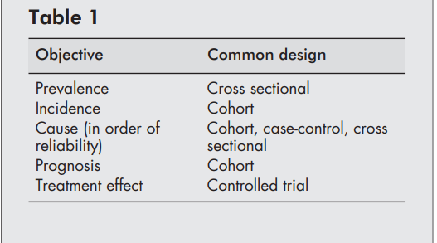

Slide 32
Cohort Studies
The best method for determining the incidence and natural history of a condition
The studies may be prospective or retrospective
Prospective Cohort Studies: A group of people are chosen who do not have the outcome of interest (e.g. diabetes). The investigator then measures a variety of variables that might be relevant to the development of the condition
Over a period, the people in the sample are observed to see whether they develop the outcome of interest (e.g. diabetes)
(Mann)

Slide 33
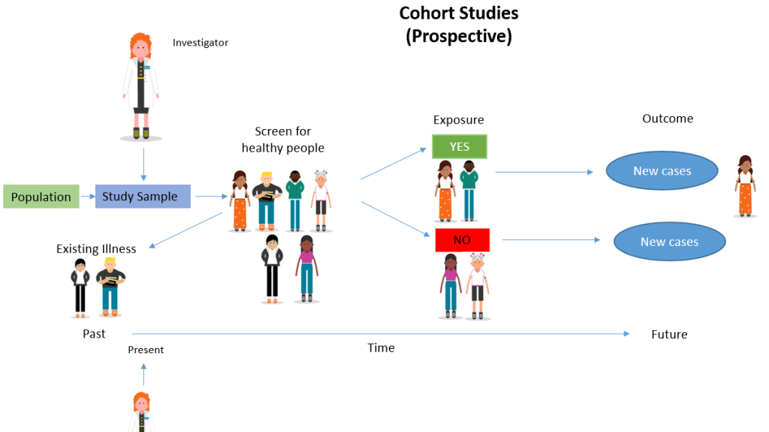

Slide 34
Retrospective Cohort Study
Historical longitudinal study in which researches look BACK to a certain point to analyse a particular group of subjects who have already experienced an outcome of interest
Use data already collected for other purposes.
The cohort is followed up retrospectively
The study period may be many years to complete
For example, a researcher might identify a group of people who have smoked and a group who never smoked and look back to determine the rate of lung cancer between the groups
(Mann)

Slide 35
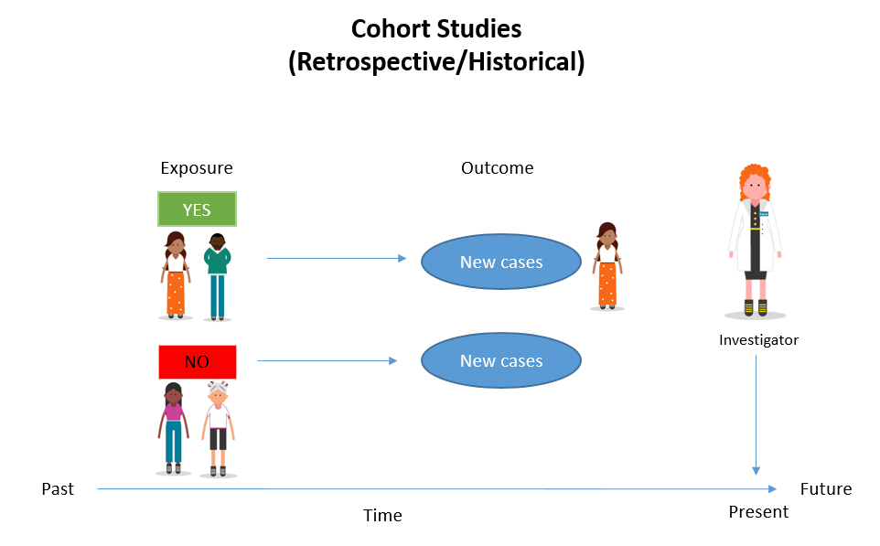

Slide 36
Cross sectional studies
Used to determine prevalence
Prevalence = the number of cases in a population at a given point in time
Important as it influences the likelihood of any particular diagnosis
Can be taken at one point of time or over time (longitudinal)

Slide 37
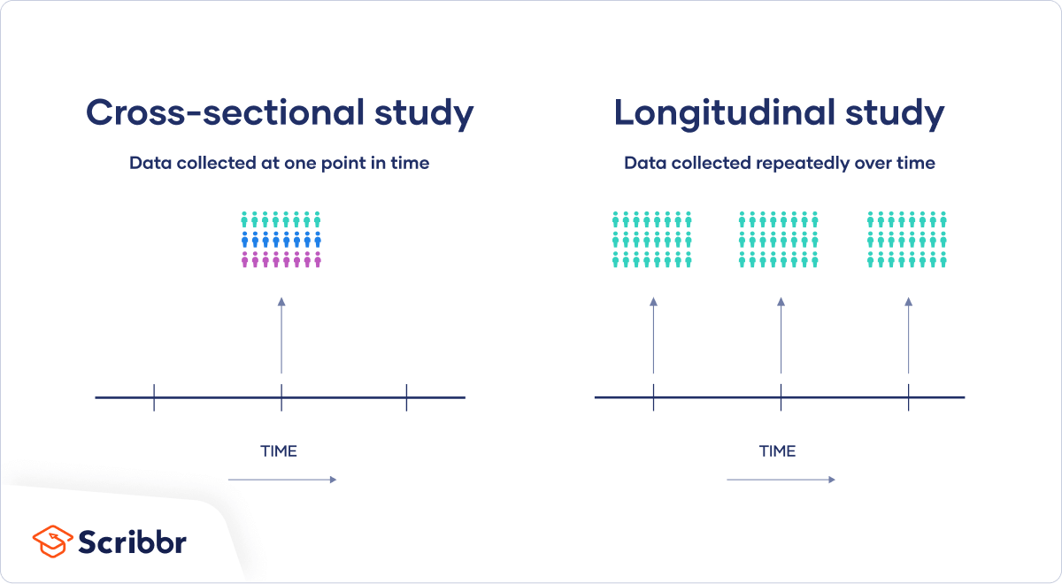

Slide 38
Case Control Studies
Usually retrospective
People with the outcome of interest are matched with a control group who do not
Retrospectively the researcher determines which individuals were exposure to the outcome of interest
Case control studies determine the relative importance of a predictor variable in relation to the presence or absence of the disease
(Mann)

Slide 39
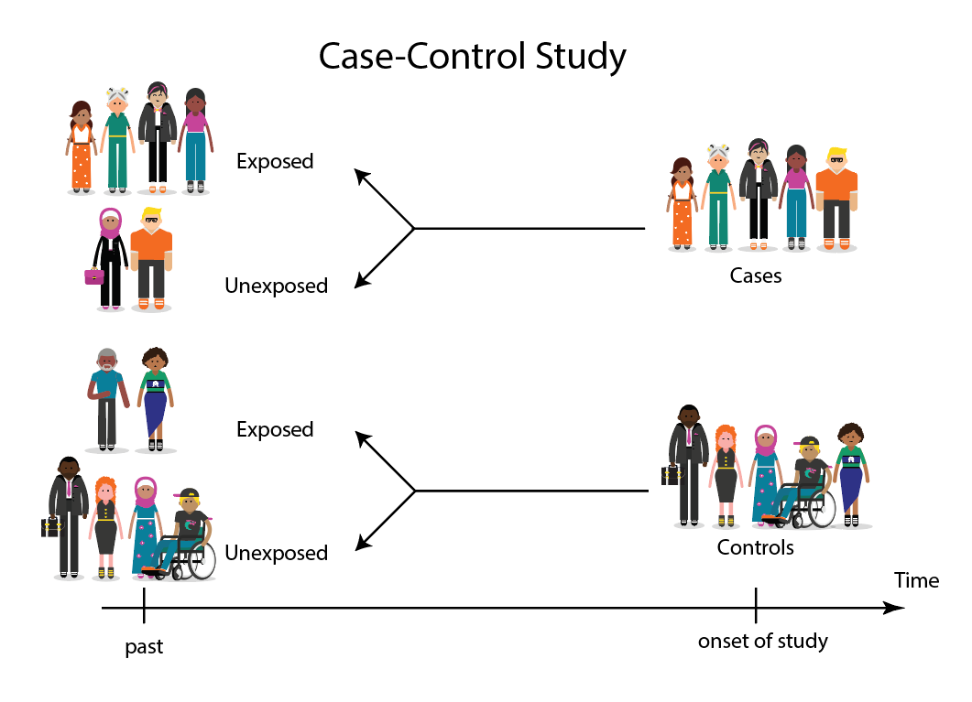

Slide 40
Experimental vs Observational Designs
Feature | Experimental (e.g., RCT) | Observational (e.g., cohort, case‑control, cross‑sectional)
Manipulation of exposure | Yes | No
Randomisation | Yes | No
Ethical constraints | Often high | Usually low
Real‑world applicability | Sometimes limited | Often high

Slide 41
Strengths and Limitations:
When RCTs are ideal:
You need to test causal impact of an intervention
Ethical and practical to assign treatments
When observational studies are ideal:
Studying long term prognosis
When randomisation is not ethical or possible
Investigating multiple exposure of outcomes
Real world context / effects

Slide 42
References
Bhide, A., Shah, P.S. and Acharya, G. (2018). A Simplified Guide to Randomized Controlled Trials. Acta Obstetricia Et Gynecologica Scandinavica, 97(4), pp.380–387. doi:https://doi.org/10.1111/aogs.13309.
Estellat, C., Torgerson, D.J. and Ravaud, P. (2009). How to perform a critical analysis of a randomised controlled trial. Best Practice & Research Clinical Rheumatology, 23(2), pp.291–303. doi:https://doi.org/10.1016/j.berh.2009.03.003.
Hariton, E. and Locascio, J.J. (2018). Randomised Controlled Trials - the Gold Standard for Effectiveness Research. BJOG: an International Journal of Obstetrics & Gynaecology, [online] 125(13), p.1716. doi:https://doi.org/10.1111/1471-0528.15199.
Mann, C.J. (2003). Observational research methods. Research design II: cohort, cross sectional, and case-control studies. Emergency Medicine Journal, [online] 20(1), pp.54–60. doi:https://doi.org/10.1136/emj.20.1.54.

